Slide 1






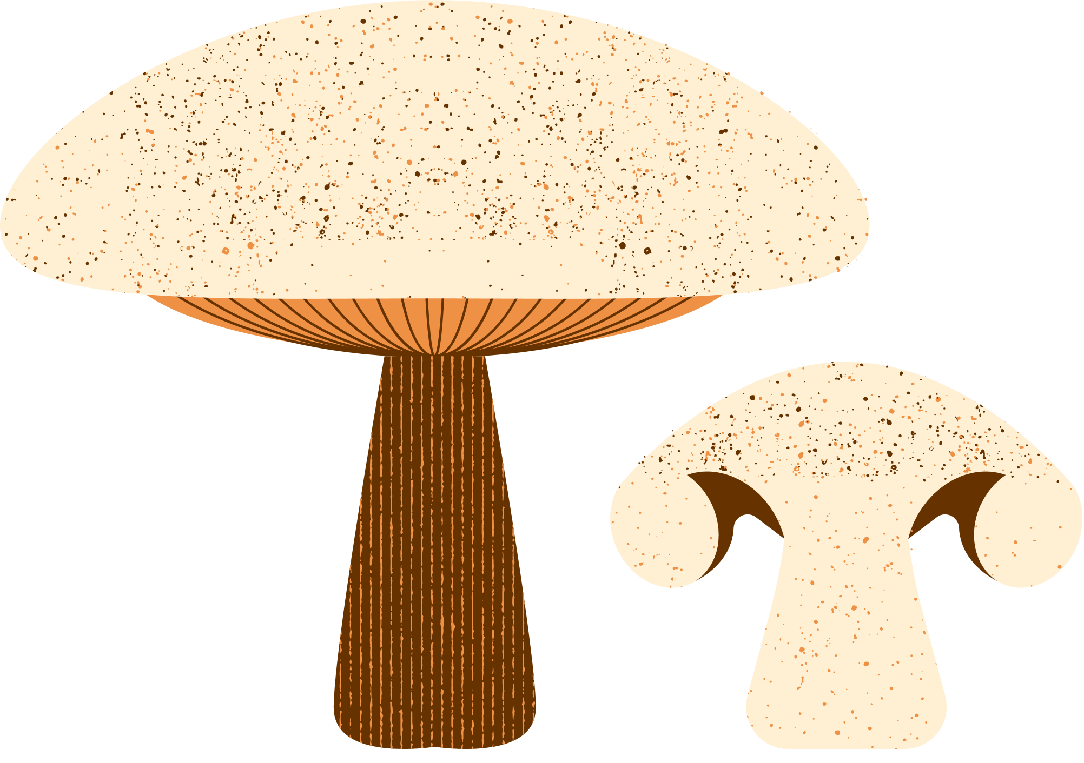


FoodieExpress
Created By:
Brian Palmer
Vu Ton
Angela Ozelski

Slide 2


Introduction
Database Design
Data Model
User-Friendly Interface
Vast Restaurant Options
Seamless Ordering Process
Real-time Order Tracking
Special Offers and Discounts
Customer Reviews and Ratings
How It Works
Benefits for Restaurant Partners
Conclusion
Table of Contents

Slide 3

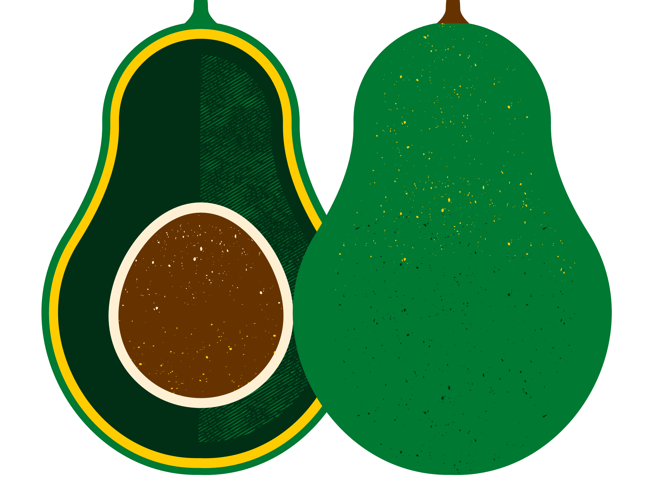
Introduction
Introduction
Brief overview of the food delivery app project
Importance of using SQL in the development

Slide 4
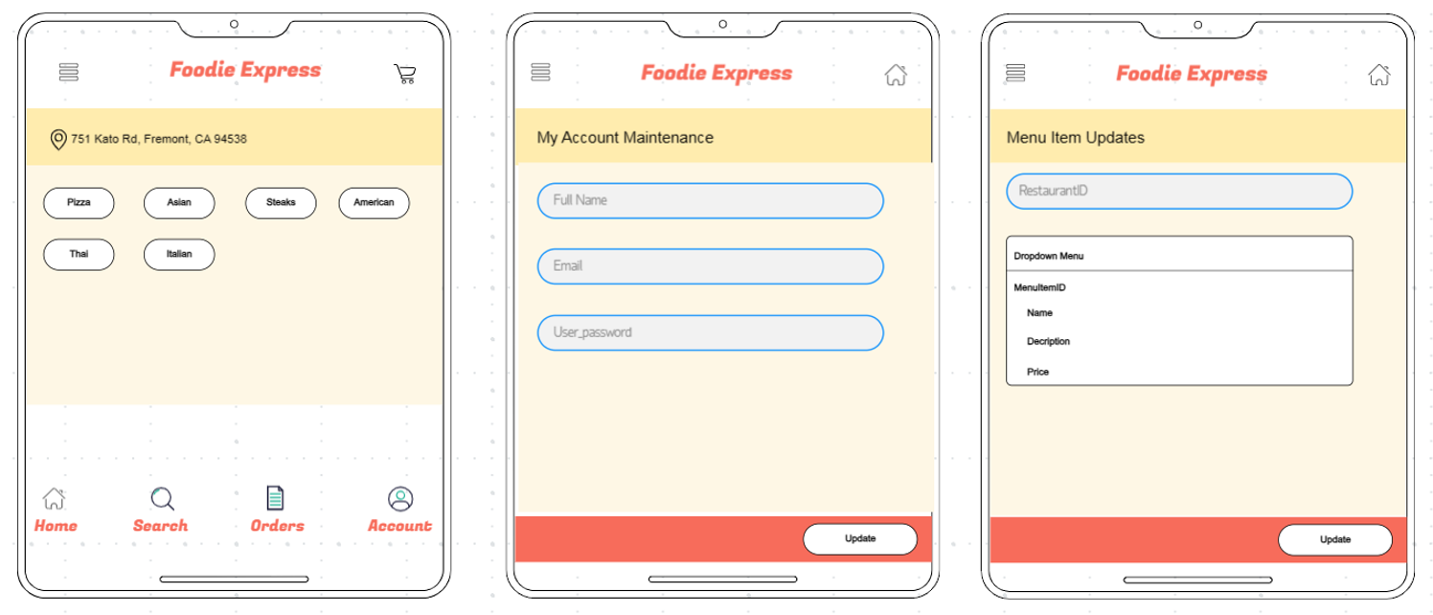
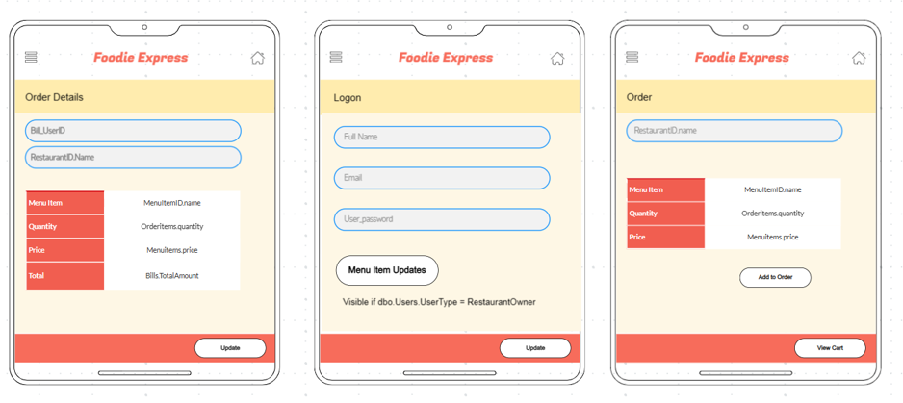

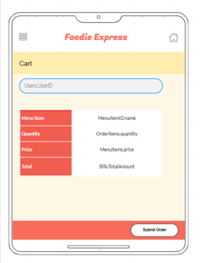
Database Design
Entity-Relationship Diagram (ERD)
Database schema
Tables and relationships

Slide 5
Data Model
Overview of the main entities:
Restaurants
Customers
Orders
Menu Items

Slide 6




User-Friendly Interface!
Overview of the app's easy-to-use design
Intuitive navigation for customers

Slide 7

Vast Restaurant Options
Showcase the variety of restaurants available on the app
Highlight popular cuisines and dining choices

Slide 8
Seamless Ordering Process
Walkthrough of the simple and quick order placement
Customization options for meals

Slide 9







Customer Reviews and Ratings
Showcase positive feedback and testimonials
How the app helps users make informed decisions

Slide 10
Special Offers and Discounts
Highlight any promotional deals or loyalty programs
Savings and benefits for regular customers

Slide 11
How It Works

Slide 12
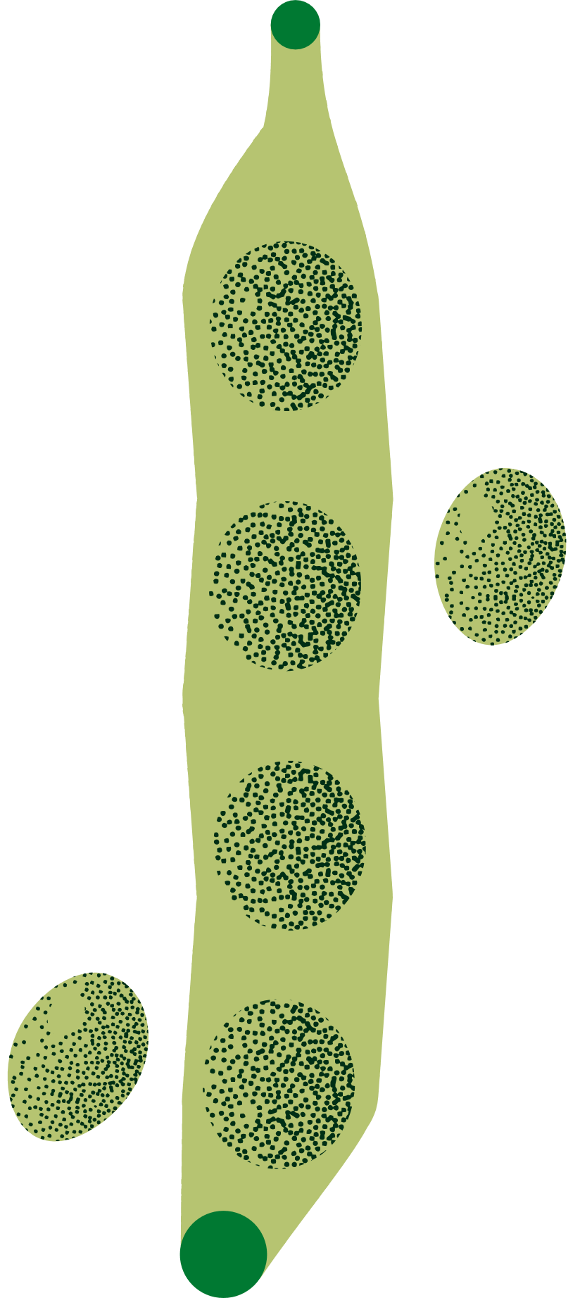


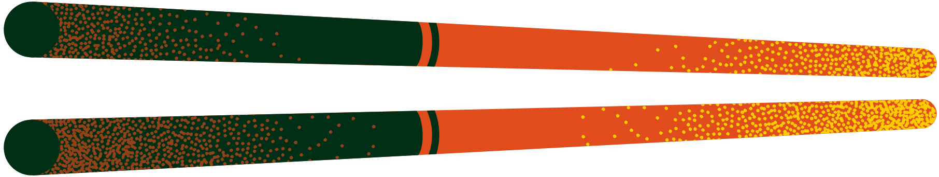
Benefits for Restaurant Partners
Briefly touch on benefits for restaurants partnering with the app
Increased visibility, reach, and customer engagement

Slide 13
Conclusion
Add text

Slide 14




Resource
Page
Use these design resources in your Canva Presentation. Happy designing!
Don't forget to delete this page before presenting.

Slide 15
BACKUP SLIDE IDEAS:
Query Examples
Common SQL queries used in the food delivery app
Retrieving data from multiple tables (joins)
Filtering and sorting data
Aggregation functions
Challenges and Solutions
Discuss any challenges faced during the SQL implementation
Solutions or workarounds applied
Q&A
Open the floor for questions and answers

